Slide 1
Technology and The Hiring Process
By: Jerod Williams

Slide 2
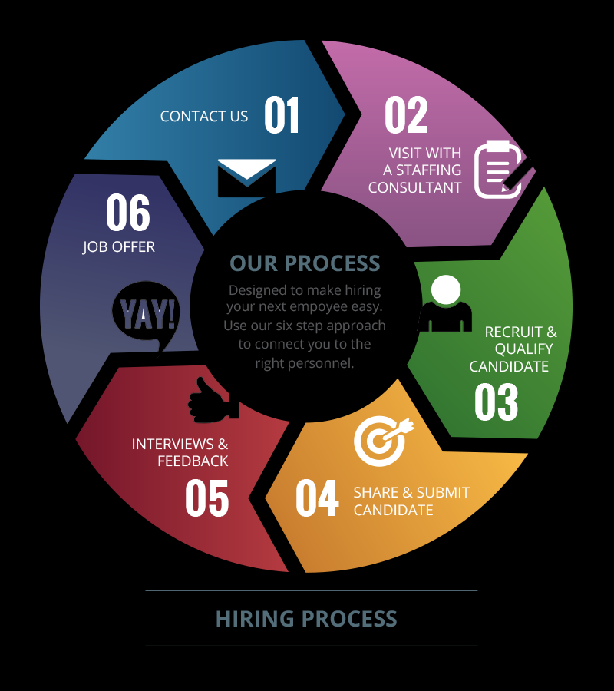
Introduction
Job Descriptions
Technology Incorporation
Recruitment and Training
Job Description Integration
Notes:
Instrumental essentials that modern day developments utilize to retrieve and attract relevant candidates for perspective jobs can be exploited by evaporating their direct necessity through job descriptions. Effective technology embedded within modern day job descriptions can sufficiently enhance organization ability to detect and select employees in which formulate a prototypical and congeal corporate culture. Beneficial traits that can be revealed from the correlation can be seen by firm’s ability to recruit the appropriate employee and effectively train the employee relating to the solidified job description. Baseline job descriptions should integrate with legal compliance measures, workers compensation, and compliance relating to unemployment claims.

Slide 3
Updated Job Descriptions
Job Description Oriented
Litigation Avoidance
Example
Lawsuit Prevention
Notes:
One key aspect linking to how job descriptions have been updated can be shown within legal compliance. Emphasis within this aspect circulates around creating job descriptions that are aligned to company policies and meets perspective standards of conduct. Modern day corporations must select employees that are aligned to corporate legal measures of the specified job description. Unsatisfactory results from selecting individuals who do not meet the required compliance measures can be a downward slope linking to litigation (Taylor & Stern, 2009). A coagulated example of a legal compliance situation can be a corporation who hires a candidate that is required to have five years of experience but only has three and is hired based on referral. The corporation can be sued because they were not loyal to their exploited job description.

Slide 4
Updated Job Descriptions
Measures of Clarity
Validate Relevant Target
Maximize Retaining
Examples
Notes:
Another key component showing linking to how modern-day job description have be updated centralizes around job description clarity. Formulation of clarity within the job description development process can be exposed by understanding the business market, understanding corporate culture, developing a strategic plan, building employment brand, and development of sales mentality alongside with an awards program for talent acquisition (Taylor & Stern, 2009). Interpretation of the elements stated above can assure the appropriate target is withdrawn, minimize any characteristics relating to employee retention, and maximize the corporation’s ability to retain employees. Examples of job description clarity can be depicted by showing emphasis on the corporations must vs wants, precise responsibilities, and accountability.

Slide 5
Updated Job Descriptions
Performance-Oriented
Emphasize Incentives
Enhanced Organizational Discussion
Personality Test
Protective Element
Notes:
Developing job descriptions linking to performance is another modern-day technique that many establishments utilize. Creation of job descriptions that emphasize incentives that reflect performance can serve as a motivational factor linking to identifying and embracing the relevant employee. By doing so organizational discussion can be more objective, predictable, and beneficial to the perspective employee, manager, and organization due to anointment of available rewards that will be appointed based on dedication, persistence, loyalty, ethical practice, and experience. Collaborating with performance indicators within job description establishments can utilize personality test embedded within the interview process to predict and validate the cultural candidate is selected. Other key benefits of performance oriented job descriptions are protection from fraudulent unemployment claims or lawsuits and good for business due to improving customer satisfaction, productivity, and profitability.

Slide 6
Updated Job Descriptions
Benefits
Software Sources
Convenience for Job Seekers
Heighten Search Engine
Notes:
Cloud Technology is another source in which modern-day job descriptions have been updated. Benefits that can be resembled within corporations include identification and leverage of resources, enhanced target window, and clarity within the evaluation stages. Congealed sources of software include: Greenhouse, ApplicantStack, Recruitee, and Jobvite. Establishments can utilize the listed sources to optimize the recruiting process, conduct more focused interviews, and make hiring decisions based on pre-evaluated data. Utilization can also be a convenience to job seekers due to having the capability to apply whenever and wherever they want and develop recruiter attraction. Another key essential that businesses must show emphasis within implementation is development of unique content other than text to depict job descriptions. Utilization will also heighten search engine results and validate job posting are presented to the relevant employee.

Slide 7
Recruitment
Four Step Process
Step 1: Requisition Development
Step 2: Attracting Candidates
Step 3: Screening
Step4: Hiring
Notes:
Technology can be beneficial to corporations by enhancing recruiting practices. An effective systematic process can be utilized to amplify results. A common four step method that many corporations utilize initiates with requisition development, attracting candidates, candidate screening, and candidate hiring. The use of appropriate technology can simplify the recruitment process listed above. Beneficial software linking to req development can be utilized to conduct sentiment analysis and result in a more appealing job description which link to finding the fit candidate (Min, 2016). Phase two of the systematic process can be exploited through corporation’s ability to source information from recruiting software that utilizes algorithms to direct and identify passive candidates (Min, 2016). Technology utilized to screen employees can be beneficial by preventing having to manually screen resumes and allow the software to withdraw resumes based on pre-evaluated data (Min, 2016). In the final hiring phase software can be utilized to conduct interviews online and automate interview scheduling (Min, 2016).

Slide 8
Recruitment
Tips For Software Selection
Define Targeted Problems
Simply Development Practices
Integration
Data Linkage
SAAS vs PAAS
Notes:
During the recruitment phase technology selection is a vital necessity relevant to acquiring perspective employees. Implementation can boost employee’s capability to define targeted problems, simply development practices, integrate with other software, and show capabilities to link data with targeted outcomes. Appropriate utilization also can be exposed as beneficial by minimizing time windows relating to recruiting practices that are performed manually, boosting onboarding, and abilities to perform background checks and pre-hire assessments (Min, 2016). A sizeable number of corporations globally utilize software-as-a-service in opposed to platform-as-a-server as their primary source due to capabilities to automatically update software and not re-install.

Slide 9
Dynamic Correlation
Popular Software
Other Exploiting Techniques
Global Versatility
Notes:
Efficiency of targeted software relating to recruitment can formulate a dynamic correlation when linked with the correct individual. Popular software models include: ClearCompany HRM, Ascentis, APS, and RUN powered by ADP. Each software show linkage to enhancements relating to quality of hires, speed of hires, experience detection, diversity correlation, and accuracy based on recruitment capacity. Other exploiting techniques include: social media platforms, business marketplaces, pay per task platforms, and artificial intelligence. Sufficient implementation can also broaden communication, simplify accessibility, and initiate professional branding. Perspective employees on a global platform in opposed to local have the capabilities to unite with other cultural employees to solidify the corporations overall mission statement is the foundational element that shows linkage within utilization.

Slide 10
Beneficial Traits
Firm Example
Web-Based and Virtual-Reality Training.
Notes:
Technology also play a significant role in training practices utilized by developments on a global platform. Beneficial traits can be revealed by emphasizing more convenience of training relating to time wise, websites capability to enhance training content regularly, accessibility from multiple devices, and low-cost relating to training exploitation (Breach, 2016). A firm example of software can be illustrated in flight simulators utilized by perspective military officers to develop relevant skills needed to perform live flight duties. Web-based and virtual reality training approaches are the most popular sources that corporations use to orchestrate training to the appropriate employee.

Slide 11
Negative Motivation
Instructor-Led Training
Microscopic Flaws
Lack of Reception
Notes:
Although technology can be exposed as beneficial within many corporation’s microscopic flaws can be identified as ineffective. Some of the flaws can be detected by individual’s frustration upon completion, unavailability of actual instructor, and level of boredom (Breach, 2016). Many individuals who attend simulated training exercises lack the reception of expert advice and questions are not answered in a timely fashion. This initiates negative motivation and formulates resistance in completing the perspective course. Corporations who identify negative motivation relating to training simulation have gradually readapted the concept of instructor led-training due to team member continuity, boosted enthusiasm, and elevated hands-on skills.

Slide 12
Top Five Sources
Benefits of Software
Formulate Competitive Edge
Understanding Organizational Strategies
Notes:
Source selection relating to training technology can be categorized by brand popularity. Top five sources for training software include: ISpring Learn, Docebo, Litmos, Matrix, and Talent LMS. Each identified software shows emphasis on flexibility, optimization, ease of access, automation, and accelerated time path. Other key takeaways that are embedded include: enhanced efficiencies, minimized turnover rate, and boosted motivation. Corporations today must formulate a competitive edge for their employees by revealing training practices alongside with training software to validate employee’s perception is positive and to assure appropriate productivity is reached (Taylor & Stern, 2009). Corporate managers must expose heighten awareness of short-term and long-term organizational strategies to precisely validate employees capabilities can be maximized.

Slide 13
Technology and The Hiring Process
Importance of Job Descriptions
Utilization of Technology Platforms
Convenience of Technology
Notes:
In summary, job descriptions are key to the thriving capability of any corporation. Finding the appropriate employee leads to financial gains, financial gains result in positive perception of shareholders and stakeholders which correlate to sustainability of the corporation’s mission statement. Job descriptions create the best predictors for job performance and ensures the appropriate candidate is selected due to precise labeling (Taylor & Stern, 2009). Modern day job descriptions, recruitment, and training are offered on numerical technology platforms that can be utilized to reached global targets, find perspective employees, and exploit training through on-line simulations. By the minute technology relating the exercises above is being developed and in time will gradually exceed and replace other practices that are performed manually due to convenience, simplicity, and accessibility.

Slide 14
Beach, David (2016). The Impact of Technology on Employee Training. Retrieved From https://www.linkedin.com/pulse/impact-technology-employee-training-david-beach
Min, JI-A (2013). 4 Ways Technology Can Improve Your Recruitment Process. Retrieved From https://ideal.com/recruitment-process/
Taylor, J., & Stern, G. (2009). Trouble with HR: An insider’s guide to finding and keeping the best people.

